Slide 1

Word Cloud
1st Nephi

Slide 2
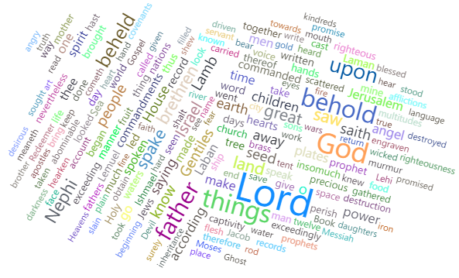
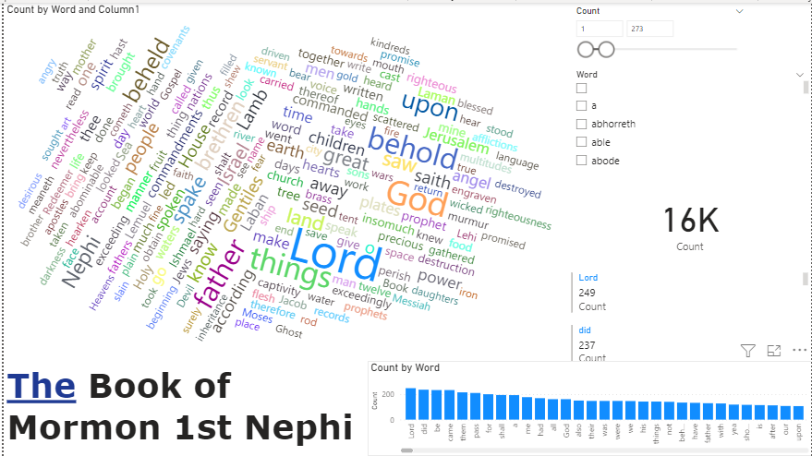
What did you build and how does it work?
I created a word cloud to visualize what are the most repeated words on the first book of Nephi. This adds each mention of the word and sizes them by the number of repetitions.

Slide 3
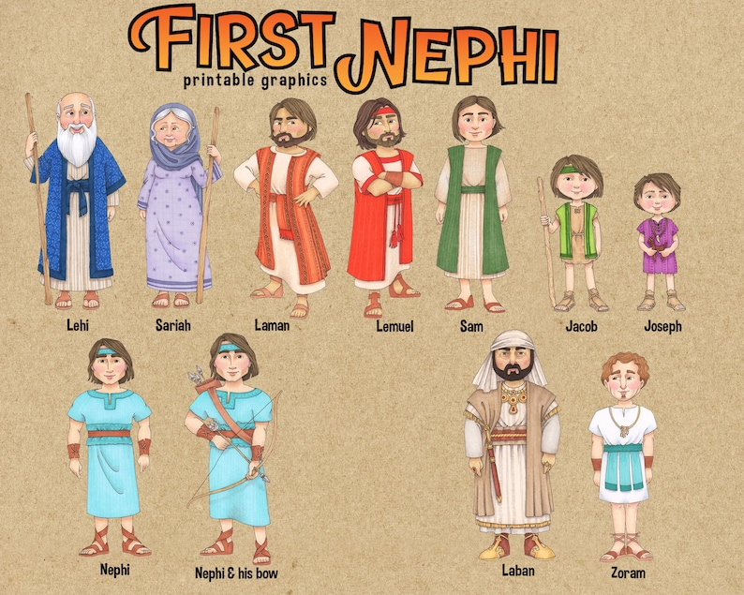
What is the purpose and objective of your dashboard?
The objective is to analyze the first book of Nephi and see if there is anything that can be learned from looking at how many times different words were repeated. And see what are the main topics communicated by Nephi.

Slide 4
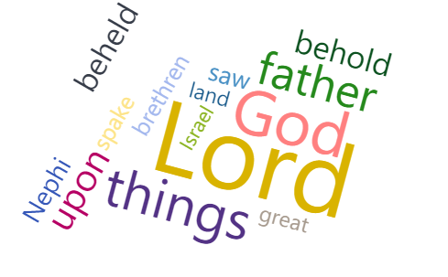
What does this dashboard teach us about your data source?
By narrowing the number of words shown, it is easier to see how the first book of Nephi is centered on God the Father and The Lord Jesus Christ

